Slide 1
April 2020 MCUL Priority Report
DAVE ADAMS
President/CEO, MCUL/CU Solutions Group

Slide 2
Federal Advocacy Agenda
Three Emergency Stimulus Bills
Phase 1
$8.3B in funding for development, manufacturing and procurement of vaccines and medical equipment
Phase 2 – Families First Coronavirus Response Act
Enhanced unemployment benefits
New employee FMLA and sick leave protections
Phase 3 – CARES Act
$350B in funds for the Payment Protection Program (PPP)
Emergency Economic Injury Disaster Loan Grants (EEIDL)

Slide 3
Federal Advocacy Agenda
Paycheck Protection Program
Expanded 7(a) loan program for:
Small businesses
Independent contractors
Others with the financial resources necessary to cover critical business expenses
The loan will be forgiven if used primarily to cover payroll
Funds can also be used for interest on
Mortgages
Rent
Utilities

Slide 4
Federal Advocacy Agenda
Paycheck Protection Program
Credit unions and other non-bank institutions that don’t currently participate in the SBA 7(a) program are authorized to participate in the Paycheck Protection Program.
More information on this program, the SBA and the credit union-related provisions in the CARES Act can be found on MCUL’s website.

Slide 5
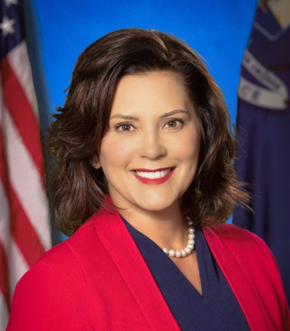
State Advocacy Agenda
Weekly Executive Orders from Governor Whitmer
A Few Orders Affecting Credit Unions
Executive Order 2020-42
Extends “Stay Home, Stay Safe” order to April 30, 2020
Executive Order 2020-47
Temporarily extends the validity of some driver’s licenses, state identification cards and vehicle registrations

Slide 6
State Advocacy Agenda
Orders Affecting Credit Unions continued
Executive Order 2020-26
Extends state and local tax filing deadlines to July
Executive Order 2020-36
Temporary restrictions on firing, disciplining or retaliating against employees who are at a heightened risk of infecting others with COVID-19
Visit the COVID-19 Information Center to read the other Executive Orders

Slide 7
Regulatory Compliance

Slide 8
Regulatory Compliance

Slide 9
Regulatory Compliance

Slide 10
Consumer Awareness
Safety and Security
New campaign narrated by fellow Michigander, Mitch Albom
$600,000 second quarter investment into Michigan-based media
Directs viewers to a newly refreshed CULinkMichigan.com website

Slide 11
Consumer Awareness
COVID-19 Resources
Stimulus check information
Best practices to avoid fraud and scams
Better Business Bureau Scam Tracker
culink.com

Slide 12
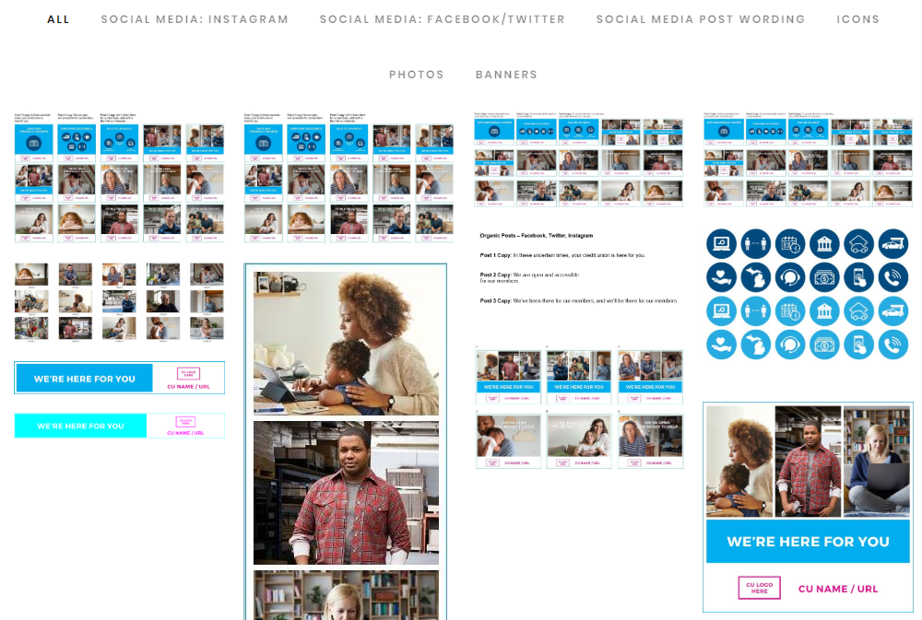
Consumer Awareness
Integration Assets
Customizable videos
Social media posts
Web banners
And more…
MCUL.org/culink

Slide 13
Michigan Credit Union Foundation
MCUF is poised to help boost community support initiatives for:
Small businesses
Front line workers
Food banks
Contact Beth Troost

Slide 14
Michigan Credit Union Foundation
Michigan Enhanced Financial Counseling Certification Training
Board of Trustees Election – June 2020
Taking self-nominations now
Two open board seats
Visit mcuf.mcul.org for more information

Slide 15
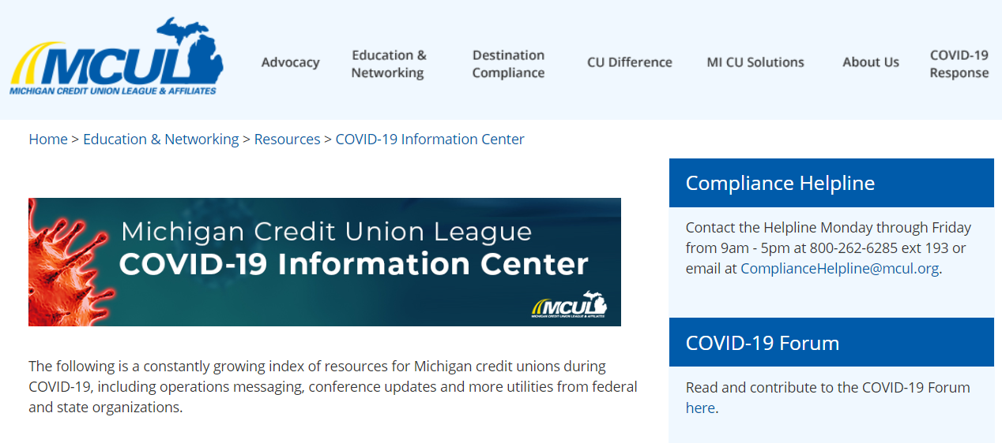
Education
Visit mcul.org

Slide 16
Education
Annual Convention and Exposition
September 18-20 | Grand Traverse Resort & Spa, Traverse City

Slide 17
CU Solutions Group
Credit Union-Focused Marketing Videos
Reinforce not-for-profit, people-first service mantra
Emergency loans
Loan restructuring
Deferred payments
Vidfuel.com

Slide 18
CU Solutions Group
COVID-19 feedback survey within MemberView analytics platform
Can be leveraged immediately in COVID-19 email and website communications
Collect and capture insights on how your credit union messaging, employees and crisis management processes are meeting the needs of members

Slide 19
CU Solutions Group
Currently helping credit unions update their marketing assets and communications to account for the extended tax deadline
Developed extended marketing plans for credit unions to:
increase member engagement
Inform members on how the CARES Act impacts filing

Slide 20
CU Solutions Group
PureChat
Add communication and service delivery capabilities to CU website
SilverCloud provides credit unions access to automated remote technologies such as:
Automated member support
Turnkey chat bots
Enhanced employee support

Slide 21
CU Solutions Group
Virtual Team Collaboration
Collaborate on daily tasks tied to goals and strategic objectives
Generate reports to bring management, executives and the board up to speed on strategic and operational plan progress

Slide 22
CU Solutions Group
Crisis-related educational content available to credit unions at no cost
Over a dozen courses, including:
Establishing Effective Virtual Teams
Becoming a Successful Collaborator
Managing During Crisis
Assessing and Responding to Risk
Governance and Financial Impact
Lending in Hard Times
Top Questions Credit Unions are Asking

Slide 23
April 2020 MCUL Priority Report
DAVE ADAMS
President/CEO, MCUL/CU Solutions Group

